Slide 1
In the Pursuit of Balance
Examining standard approaches to randomized Experiments
Control
Treated
Tyler Hicks, Ph.D.
University of Kansas
Jeff Kromrey, Ph.D.
University of South Florida
Were the Comparison Groups Equivalent?

Slide 2
The Agenda:
We hope to do more than admire a problem. We wish to propose a testable solution.
Thesis 1:
When sample sizes are small, group equivalency may be established with deliberate calculation rather than randomization.
Thesis 2:
When such a “quasi-experimental” design is used, switch to a Bayesian paradigm to make sense of statistical inferences.
$$P(θ|Y)∝L\left(Y | θ\right)P(θ)$$

Slide 3
Thought Experiment

Slide 4
What would you do?
Traditional comprehensive reading programs exclude students with cognitive disabilities. Imagine you thus designed a special reading program for this neglected population. Imagine further you are conducting an experiment to demonstrate this reading program works better than conventional methods. Given the low prevalence of cognitive disabilities in the human population you will likely find about 4 eligible students in a typical elementary school.
 | Gender | IQ | Ethnicity | Grade
Tim | M | 69 | W | 4th
Toni | F | 65 | B | 2nd
Tammy | F | 68 | H | 3rd
Tom | M | 64 | W | 4th
How should you proceed?

Slide 5
What would you do?
Traditional comprehensive reading programs exclude students with cognitive disabilities. Imagine you thus designed a special reading program for this neglected population. Imagine further you are conducting an experiment to demonstrate this reading program works better than conventional methods. Given the low prevalence of cognitive disabilities in the human population you will likely find about 4 eligible students in a typical elementary school.
 | Gender | IQ | Ethnicity | Grade
Tim | M | 69 | W | 4th
Toni | F | 65 | B | 2nd
Tammy | F | 68 | H | 3rd
Tom | M | 64 | W | 4th
How should you proceed? One option might be simple randomization.

Slide 6
What would you do?
Traditional comprehensive reading programs exclude students with cognitive disabilities. Imagine you thus designed a special reading program for this neglected population. Imagine further you are conducting an experiment to demonstrate this reading program works better than conventional methods. Given the low prevalence of cognitive disabilities in the human population you will likely find about 4 eligible students in a typical elementary school.
 | Gender | IQ | Ethnicity | Grade
Tim | M | 69 | W | 4th
Tom | M | 64 | W | 4th
Toni | F | 65 | B | 2nd
Tammy | F | 68 | H | 3rd
How should you proceed? Another option might be blocked-paired randomization.
First Step – Create Matched-Pairs

Slide 7
What would you do?
Traditional comprehensive reading programs exclude students with cognitive disabilities. Imagine you thus designed a special reading program for this neglected population. Imagine further you are conducting an experiment to demonstrate this reading program works better than conventional methods. Given the low prevalence of cognitive disabilities in the human population you will likely find about 4 eligible students in a typical elementary school.
 | Gender | IQ | Ethnicity | Grade
Tim | M | 69 | W | 4th
Tom | M | 64 | W | 4th
Toni | F | 65 | B | 2nd
Tammy | F | 68 | H | 3rd
How should you proceed? Another option might be blocked-paired randomization.
First Step – Create Matched-Pairs
Second Step – Randomize within Pairs

Slide 8
What would you do?
Traditional comprehensive reading programs exclude students with cognitive disabilities. Imagine you thus designed a special reading program for this neglected population. Imagine further you are conducting an experiment to demonstrate this reading program works better than conventional methods. Given the low prevalence of cognitive disabilities in the human population you will likely find about 4 eligible students in a typical elementary school.
 | Gender | IQ | Ethnicity | Grade
Tim | M | 69 | W | 4th
Toni | F | 65 | B | 2nd
Tammy | F | 68 | H | 3rd
Tom | M | 64 | W | 4th
How should you proceed? A third option might be adaptive randomization.

Slide 9
What would you do?
Traditional comprehensive reading programs exclude students with cognitive disabilities. Imagine you thus designed a special reading program for this neglected population. Imagine further you are conducting an experiment to demonstrate this reading program works better than conventional methods. Given the low prevalence of cognitive disabilities in the human population you will likely find about 4 eligible students in a typical elementary school.
 | Gender | IQ | Ethnicity | Grade
Tim | M | 69 | W | 4th
Toni | F | 65 | B | 2nd
Tammy | F | 68 | H | 3rd
Tom | M | 64 | W | 4th
How should you proceed? A fourth option would be to deliberately assign students.
Option 4a – Simple Deliberate Assignment
Option 4b – Blocked-Paired Deliberate Assignment

Slide 10
Background

Slide 11
Randomized Experiments
Were the Comparison Groups Equivalent?
“Randomization is so commonplace” that “most suppose that the practice is quite uncontroversial. That is not so... Opponents of randomization as a universal practice may well say that it should be restricted to precisely the kinds of work where it started: work marked chiefly by complete ignorance.”
Ian Hacking
Philosopher
Source of Citation:
Hacking, I. (1988). Telepathy: Origins of Randomization in Experimental Designs.
History of Science Society. 79. 427-451.

Slide 12
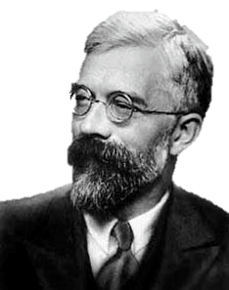
Randomized Experiments
One Logic, Many Forms
Simple Randomization Design
Block Randomization Design
Latin Squares
Matched-Pairs
Adaptive Randomization Design
RA Fisher
Scholarly Reference:
Fisher, R.A. (1935). The Design of Experiments (9th Ed). New York, NY: Macmillan

Slide 13
Rationale for Randomization
The Standard Three-Pronged Defense
It underpins frequentist statistical inference
It eliminates a certain kind of researcher bias
It, on average, balances groups on covariates
RA Fisher
Reason # 3 Likely to have the Broadest Appeal, if trait considered to be a virtue
Scholarly Reference:
Fisher, R.A. (1935). The Design of Experiments (9th Ed). New York, NY: Macmillan

Slide 14
Imbalanced Groups (Cont.)
Statistical flukes in randomized experiments
Modern Statistical Theory
With k independent covariates, the chance of at least one covariate showing a significant difference, at level $α$, is $1−{\left(1−α\right)}^{k}.$
0.2$3≈1−{\left(1−0.05\right)}^{5}$
0.4$≈1−{\left(1−0.05\right)}^{10}$
0.6$5≈1−{\left(1−0.05\right)}^{20}$
“…the uncontrolled causes which may influence the results are always strictly innumerable”
-RA Fisher

Slide 15
Imbalanced Groups
Statistical flukes in randomized experiments
 | X1 | X2 | Xk
Case 1 | 1 | A | A
Case 2 | 0 | B | C
….
Case n | 1 | C | D
Modern Statistical Theory
…
The risk that a treatment/covariate interaction effect will fail to manifest in a small experiment is excessive due to the small likelihood of obtaining the magical combination by chance.
Scholarly Reference:
Krause, M.S. & Howard, K.I. (2003). What random assignment does and does not do. Journal of Clinical Psychology. 7, 751-766.

Slide 16
Stimulation Study

Slide 17
Returning to our motivating example
Traditional comprehensive reading programs exclude students with cognitive disabilities. Imagine you thus designed a special reading program for this neglected population. Imagine further you are conducting an experiment to demonstrate this reading program works better than conventional methods. Given the low prevalence of cognitive disabilities in the human population you will likely find about 4 eligible students in a typical elementary school.
 | Gender | IQ | Ethnicity | Grade
Tim | M | 69 | W | 4th
Toni | F | 65 | B | 2nd
Tammy | F | 68 | H | 3rd
Tom | M | 64 | W | 4th
How should you proceed?

Slide 18
Simulation Design
SAS 9.4
Independent Variables (Simple, Blocked, or Adaptive Randomization)
Dependent Variables
Experimental Conditions
Total Sample Sizes (4, 6, 8, 10, 100)
Correlation between covariates and outcome (.2, .5, .8)
Consistency of relationship between covariates and outcome (Identical, Slanted towards Treated Group)
Number of Blocks (1, 10, 20)
Sample size per Block (4, 8, 12, 50)
5,000 or 50,000 reps
The Model: t-test of independent means or ANOVA

Slide 19
Simple Randomization
Frequency Properties:
Unbiased Point Estimates for both X and Y
Type I Error Controlled for both X and Y

Slide 20
Simple Randomization (Cont.)
Note. Depicts RMSE Information for Covariate X X~N(0,1)

Slide 21
Simple Randomization (Cont.)
Note. Depicts RMSE Information for Outcome Y Y~N($[β_{1}$T+$β_{2}$X],1)

Slide 22
Hypothesis tests
Covariate X
Outcome Y
Simple Randomization

Slide 23
Point Estimates for Cohen’s d
Covariate X
Outcome Y
Simple Randomization

Slide 24
Point Estimates for Hedge’s g
Covariate X
Outcome Y
Simple Randomization

Slide 25
Large imbalanced sampled
Covariate X
Outcome Y
Simple Randomization

Slide 26
Adaptive Randomization
Adaptive Frequency Properties:
Unbiased Point Estimates for both X and Y
Type I Error Overcontrolled for both X and Y

Slide 27
Adaptive Randomization (Cont.)
$$P(\left|d\right|>8)$$
Parametric T-test
Type I error Overcontrol
Adaptive Randomization Test
Type I error Control

Slide 28
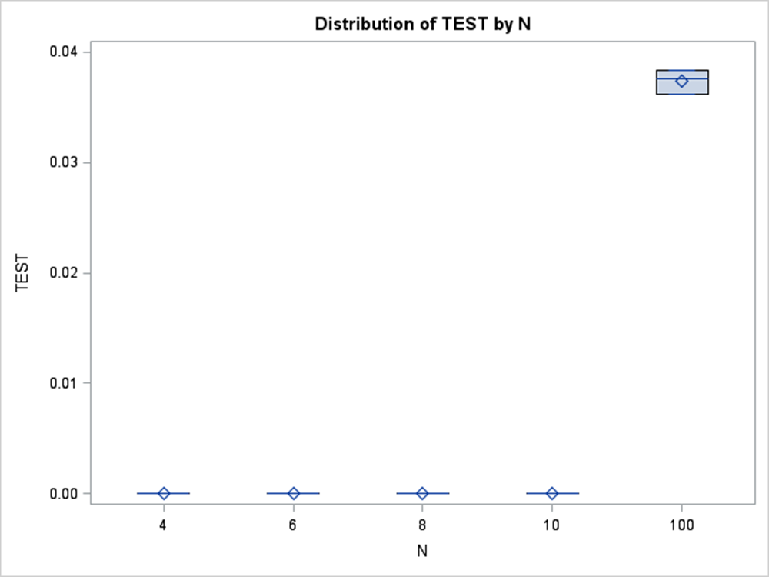
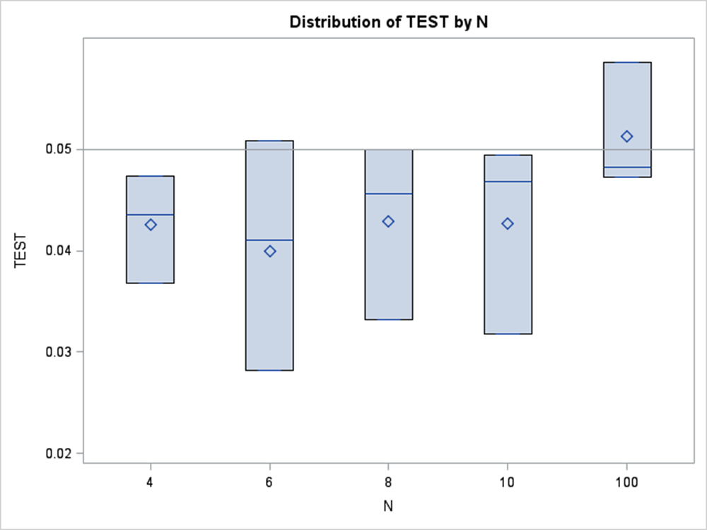
Hypothesis tests
Covariate X
Outcome Y
Note: Obviously, always going to be zero with small n.
Adaptive Randomization

Slide 29
Point Estimates for Cohen’s d
Covariate X
Outcome Y
Adaptive Randomization

Slide 30
Large imbalanced sampled
Covariate X
Outcome Y
Adaptive Randomization

Slide 31
Interaction
<Insert Simulation Results>

Slide 32
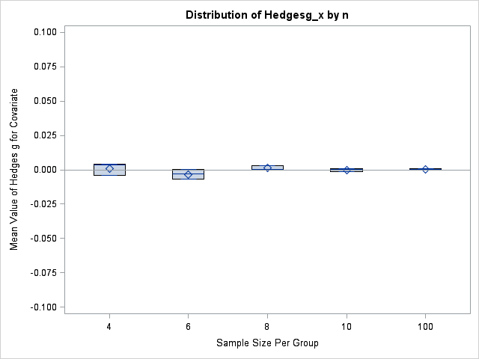
Interaction: Covariate Bias
<Insert Simulation Results>

Slide 33
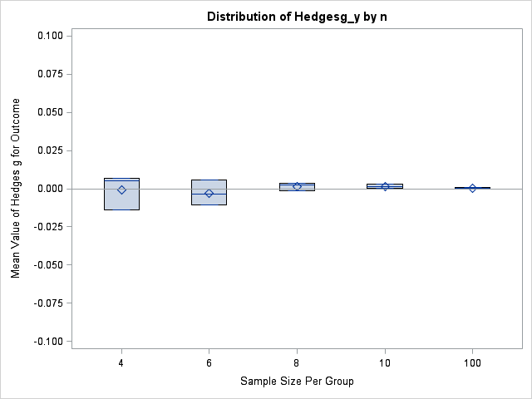
Interaction: Outcome Bias
<Insert Simulation Results>

Slide 34
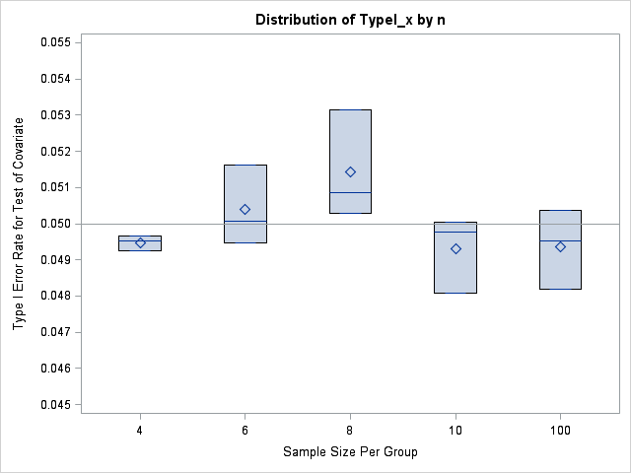
Interaction: Covariate Type I Error Rate
<Insert Simulation Results>

Slide 35
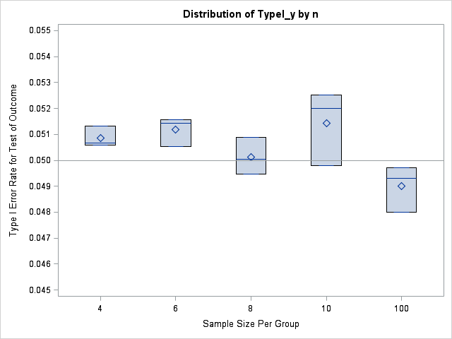
Interaction: Outcome Type I Error Rate
<Insert Simulation Results>

Slide 36
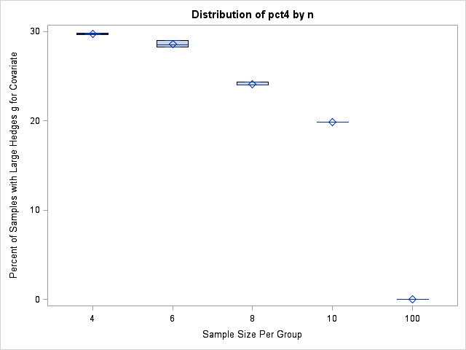
Interaction: Large Covariate Effect Sizes
<Insert Simulation Results>

Slide 37
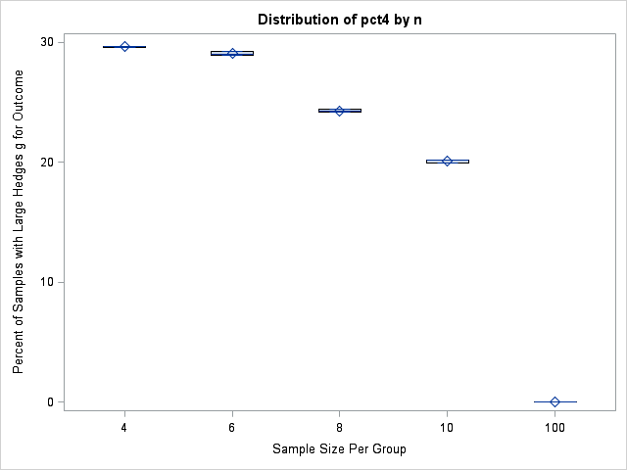
Interaction: Large Outcome Effect Sizes
<Insert Simulation Results>

Slide 38
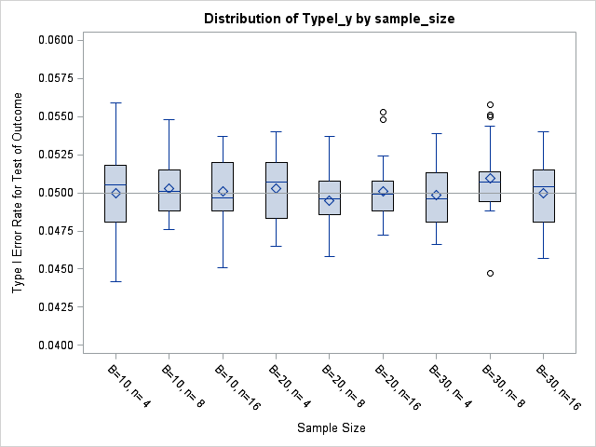
Randomized Blocks: Type I Error Rate
<Insert Simulation Results>

Slide 39
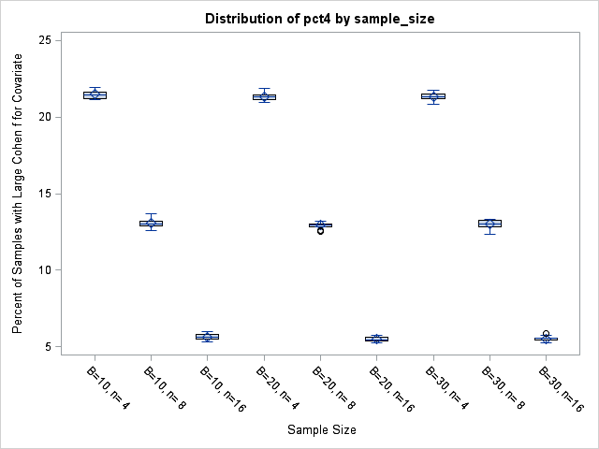
Randomized Blocks: Large Covariate Effect Size
<Insert Simulation Results>

Slide 40
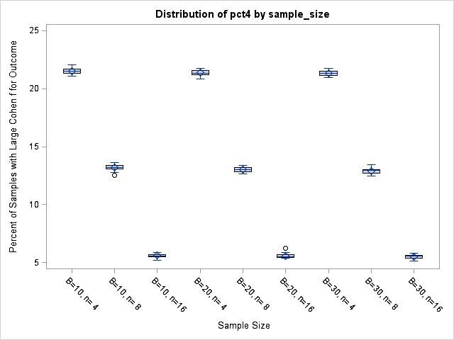
Randomized Blocks: Large Outcome Effect Size
<Insert Simulation Results>

Slide 41
Replication Randomized Block Method
<Insert Simulation Results>

Slide 42
Overview of Alternate Approach

Slide 43
Returning to our motivating example
Traditional comprehensive reading programs exclude students with cognitive disabilities. Imagine you thus designed a special reading program for this neglected population. Imagine further you are conducting an experiment to demonstrate this reading program works better than conventional methods. Given the low prevalence of cognitive disabilities in the human population you will likely find about 4 eligible students in a typical elementary school.
 | Gender | IQ | Ethnicity | Grade
Tim | M | 69 | W | 4th
Tom | M | 64 | W | 4th
Toni | F | 65 | B | 2nd
Tammy | F | 68 | H | 3rd
First step – Make Matching Pairs
Second step – Within matched pairs, assign one to the treated condition; the other, control condition.
Third step – Decide whether to randomly assign or deliberately assign.

Slide 44
What you know counts
Were the Comparison Groups Equivalent?
PROPOSAL
The researcher asks participating teachers who know the students to create equivalent groups. Then the researcher picks one to be the control and one to be the treatment.
Alternatively, the researcher may use statistical methods, such as clustering, to assign students into control and treated conditions based on their similarity on baseline prognostic factors.
Scholarly Reference:
Howson, C. & Urbach, P. (2005). Scientific Reasoning: The Bayesian Approach (3rd Ed). New York, NY: Open Court.

Slide 45
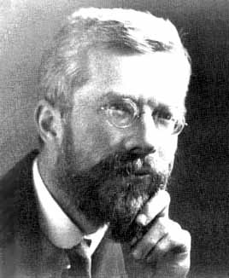
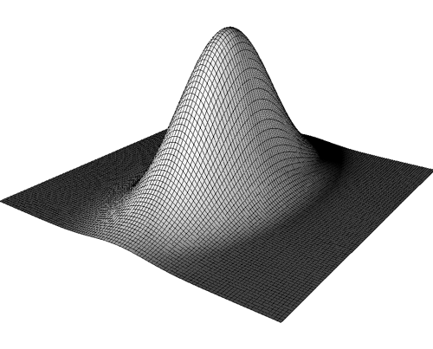
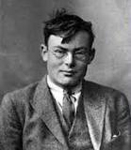
Two Statistical Inferences
Chance-Type
Requires Randomization
RA Fisher
1890-1962
Sampling Density P(D|H)
Credence-Type
Does not Require Randomization
Frank Ramsey
1903-1930
Posterior Density
P(H|D)
Notes:
Custom animation effects: object spins on end
(Advanced)
To reproduce the background effects on this slide, do the following:
On the Home tab, in the Slides group, click Layout, and then click Blank.
Right-click the slide background area, and then click Format Background. In the Format Background dialog box, click Fill in the left pane, and then select Solid fill in the Fill pane. Click the button next to Color, and then under Theme Colors click White, Background 1 (first row, first option from the left).
To reproduce the rectangle on this slide, do the following:
On the Home tab, in the Drawing group, click Shapes, and then under Rectangles click Rounded Rectangle (second option from the left). On the slide, drag to draw a rounded rectangle.
Select the rectangle. Drag the yellow diamond adjustment handle to the left to decrease the amount of rounding on the corners.
With the rounded rectangle still selected, under Drawing Tools, on the Format tab, in the Size group, do the following:
In the Shape Height box, enter 3.5”.
In the Shape Width box, enter 0.25”.
Under Drawing Tools, on the Format tab, in the bottom right corner of the Shape Styles group, click the Format Shape dialog box launcher. In the Format Shape dialog box, click Fill in the left pane. In the Fill pane, select Solid fill, click the button next to Color, and then under Theme Colors click White, Background 1, Darker 15% (third row, first option from the left).
Also in the Format Shape dialog box, click Line Color in the left pane. In the Line Color pane, select No line.
Also in the Format Shape dialog box, click Shadow in the left pane. In the Shadow pane, click the button next to Presets, under Outer select Offset Bottom (first row, second option from the left), and then do the following:
In the Transparency box, enter 0%.
In the Size box, enter 100%.
In the Blur box, enter 8.5 pt.
In the Angle box, enter 90°.
In the Distance box, enter 1 pt.
Also in the Format Shape dialog box, click 3-D Format in the left pane. In the 3-D Format pane, do the following:
Under Bevel, click the button next to Top, and then under Bevel click Circle (first row, first option from the left). Next to Top, in the Width box, enter 5 pt, and in the Height box, enter 5 pt.
Under Surface, click the button next to Material, and then under Standard click Matte (first row, first option from the left). Click the button next to Lighting, and then under Neutral click Soft (first row, third option from the left).
On the slide, select the rounded rectangle. On the Home tab, in the Clipboard group, click the arrow under Paste, and then click Duplicate.
Select the duplicate rectangle. On the Home tab, in the Drawing group, do the following:
Click the arrow next to Shape Fill, and then click No Fill.
Click the arrow next to Shape Outline, and then click No Outline.
Drag the second rectangle above the first rectangle until the lower edge overlays the top edge of the first rectangle. (Note: When the spinning animation effect is created later for these rectangles, the spin will center where the edges of the rectangles meet.)
Press and hold CTRL, and then select both rectangles. On the Home tab, in the Drawing group, click Arrange, and do the following:
Point to Align, and then click Align Selected Objects.
Point to Align, and then click Align Center.
Click Group.
On the slide, drag the group until it is centered horizontally on the left edge of the slide (straddling the edge).
On the Home tab, in the Drawing group, click Arrange, point to Align, and then do the following:
Click Align to Slide.
Click Align Middle.
To reproduce the dashed arc on this slide, do the following:
On the Home tab, in the Drawing group, click Shapes, and then under Basic Shapes click Arc (third row, 12th option from the left). On the slide, drag to draw an arc.
Select the arc. Under Drawing Tools, on the Format tab, in the Size group, do the following:
In the Shape Height box, enter 7.5”.
In the Shape Width box, enter 7.5”.
With the arc still selected, on the Home tab, in the Drawing group, click the arrow next to Shape Outline, and then do the following:
Under Theme Colors, click White, Background 1, Darker 15% (third row, first option from the left).
Point to Dashes, and then click Dash (fourth option from the top).
On the slide, drag the yellow diamond adjustment handle on the right side of the arc to the bottom of the arc to create a half circle.
Drag the arc until the yellow diamond adjustment handles are on the left edge of the slide.
With the arc still selected, on the Home tab, in the Drawing group, click Arrange, point to Align, and then do the following:
Click Align to Slide.
Click Align Middle.
To reproduce the half circle on this slide, do the following:
On the slide, select the arc. On the Home tab, in the Clipboard group, click the arrow under Paste, and then click Duplicate.
Select the duplicate arc. Under Drawing Tools, on the Format tab, in the Size group, do the following:
In the Shape Height box, enter 3.33”.
In the Shape Width box, enter 3.33”.
With the second arc still selected, under Drawing Tools, on the Format tab, in the Shape Styles group, click the arrow next to Shape Fill, and then under Theme Colors click White, Background 1, Darker 5% (second row, first option from the left).
Under Drawing Tools, on the Format tab, in the Shape Styles group, click the arrow next to Shape Outline, and then click No Outline.
Under Drawing Tools, on the Format tab, in the Shape Styles group, click Shape Effects, point to Shadow, and then click Shadow Options. In the Format Shape dialog box, click Shadow in the left pane. In the Shadow pane, click the button next to Presets, under Inner click Inside Right (second row, third option from the left), and then do the following:
In the Transparency box, enter 86%.
In the Blur box, enter 24 pt.
In the Angle box, enter 315°.
In the Distance box, enter 4 pt.
On the slide, drag the second arc until the yellow diamond adjustment handles are on the left edge of the slide. On the Home tab, in the Drawing group, click Arrange, and then do the following:
Point to Align, and then click Align to Slide.
Point to Align, and then click Align Middle.
Click Send to Back.
To reproduce the button shapes on this slide, do the following:
On the Home tab, in the Drawing group, click Shapes, and then under Basic Shapes click Oval (first row, second option from the left). On the slide, drag to draw an oval.
Select the oval. Under Drawing Tools, on the Format tab, in the Size group, do the following:
In the Shape Height box, enter 0.34”.
In the Shape Width box, enter 0.34”.
Under Drawing Tools, on the Format tab, in the Shape Styles group, click More, and then click Light 1 Outline, Colored Fill – Dark 1 (third row, first option from the left).
Under Drawing Tools, on the Format tab, in the bottom right corner of the Shape Styles group, click the Format Shape dialog box launcher. In the Format Shape dialog box, click Fill in the left pane. In the Fill pane, select Solid Fill. Click the button next to Color, and then under Theme Colors click Olive Green, Accent 3, Lighter 80° (second row, seventh option from the left).
Also in the Format Shape dialog box, click Line Color in the left pane. In the Line Color pane, select No line.
Also in the Format Shape dialog box, click Shadow in the left pane. In the Shadow pane, click the button next to Presets, under Outer click Offset Bottom (first row, second option from the left), and then do the following:
In the Transparency box, enter 0%.
In the Size box, enter 100%.
In the Blur box, enter 8.5 pt.
In the Angle box, enter 90°.
In the Distance box, enter 1 pt.
Also in the Format Shape dialog box, click 3-D Format in the left pane, and then do the following in the 3-D Format pane:
Under Bevel, click the button next to Top, and then under Bevel click Art Deco (third row, fourth option from the left). Next to Top, in the Width box, enter 5 pt, and in the Height box, enter 5 pt.
Under Contour, click the button next to Color, and then under Theme Colors click White, Background 1 (first row, first option from the left). In the Size box, enter 3.5 pt.
Under Surface, click the button next to Material, and then under Standard click Matte (first row, first option from the left). Click the button next to Lighting, and then under Neutral click Soft (first row, third option from the left).
On the slide, select the oval. Under Drawing Tools, on the Format tab, in the bottom right corner of the Size group, click the Size and Position dialog box launcher. In the Size and Position dialog box, on the Position tab, do the following:
In the Horizontal box, enter 2.98”.
In the Vertical box, enter 1.5”.
Select the oval. On the Home tab, in the Clipboard group, click the arrow under Paste, and then click Duplicate.
Select the duplicate oval. Under Drawing Tools, on the Format tab, in the bottom right corner of the Size group, click the Size and Position dialog box launcher. In the Size and Position dialog box, on the Position tab, do the following:
In the Horizontal box, enter 3.52”.
In the Vertical box, enter 2.98”.
Repeat step 9 two more times, for a total of four ovals. Under Drawing Tools, on the Format tab, in the bottom right corner of the Size group, click the Size and Position dialog box launcher. In the Size and Position dialog box, on the Position tab, do the following to position the third and fourth ovals:
Select the third oval on the slide, and then enter 3.52” in the Horizontal box and 4.27” in the Vertical box.
Select the fourth oval on the slide, and then enter 2.99” in the Horizontal box and 5.66” in the Vertical box.
To reproduce the text on this slide, do the following:
On the Insert tab, in the Text group, click Text Box, and then on the slide, drag to draw the text box.
Enter text in the text box and select the text. On the Home tab, in the Font group, do the following:
In the Font list, select Corbel.
In the Font Size list, select 22.
Click the arrow next to Font Color, and then under Theme Colors click White, Background 1, Darker 50% (sixth row, first option from the left).
On the Home tab, in the Paragraph group, click Align Text Left to align the text left in the text box.
On the slide, drag the text box to the right of the first oval.
Select the text box. On the Home tab, in the Clipboard group, click the arrow under Paste, and then click Duplicate.
Click in the text box and edit the text.
Drag the second text box to the right of the second oval.
Repeat steps 5-7 to create the third and fourth text boxes, dragging them to the right of the third and fourth ovals.
To reproduce the animation effects on this slide, do the following:
On the Animations tab, in the Animations group, click Custom Animation.
On the Home tab, in the Editing group, click Select, and then click Selection Pane.
In the Selection and Visibility pane, select the rectangle group. In the Custom Animation task pane, do the following:
Click Add Effect, point to Emphasis, and then click More Effects. In the Add Emphasis Effect dialog box, under Basic, click Spin.
Select the animation effect (spin effect for the rectangle group). Under Modify: Spin, do the following:
In the Start list, select With Previous.
In the Amount list, in the Custom box, enter 123°, and then press ENTER. Also in the Amount list, click Counterclockwise.
In the Speed list, select Fast.
On the slide, select the first oval. In the Custom Animation task pane, do the following:
Click Add Effect, point to Emphasis, and then click More Effects. In the Add Emphasis Effect dialog box, under Basic, click Change Fill Color.
Select the second animation effect (change fill color effect for the first oval). Under Modify: Change Fill Color, do the following:
In the Start list, select After Previous.
In the Fill Color list, click More Colors. In the Colors dialog box, on the Custom tab, enter values for Red: 130, Green: 153, Blue: 117.
In the Speed list, select Very Fast.
On the slide, select the first text box. In the Custom Animation task pane, do the following:
Click Add Effect, point to Entrance, and then click More Effects. In the Add Entrance Effect dialog box, under Subtle, click Fade.
Select the third animation effect (fade effect for the first text box). Under Modify: Fade, do the following:
In the Start list, select With Previous.
In the Speed list, select Very Fast.
In the Selection and Visibility pane, select the rectangle group. In the Custom Animation task pane, do the following:
Click Add Effect, point to Emphasis, and then click More Effects. In the Add Emphasis Effect dialog box, under Basic, click Spin.
Select the fourth animation effect (spin effect for the rectangle group). Under Modify: Spin, do the following:
In the Start list, select On Click.
In the Amount list, in the Custom box, enter 22°, and then press ENTER. Also in the Amount list, click Clockwise.
In the Speed list, select Very Fast.
On the slide, select the second oval. In the Custom Animation task pane, do the following:
Click Add Effect, point to Emphasis, and then click More Effects. In the Add Emphasis Effect dialog box, under Basic, click Change Fill Color.
Select the fifth animation effect (change fill color effect for the second oval). Under Modify: Change Fill Color, do the following:
In the Start list, select After Previous.
In the Fill Color list, click More Colors. In the Colors dialog box, on the Custom tab, enter values for Red: 130, Green: 153, Blue: 117.
In the Speed list, select Very Fast.
On the slide, select the second text box. In the Custom Animation task pane, do the following:
Click Add Effect, point to Entrance and then click More Effects. In the Add Entrance Effect dialog box, under Subtle, click Fade.
Select the sixth animation effect (fade effect for the second text box). Under Modify: Fade, do the following:
In the Start list, select With Previous.
In the Speed list, select Very Fast.
On the slide, select the third oval. In the Custom Animation task pane, do the following:
Click Add Effect, point to Emphasis, and then click More Effects. In the Add Emphasis Effect dialog box, under Basic, click Change Fill Color.
Select the seventh animation effect (change fill color effect for the third oval). Under Modify: Change Fill Color, do the following:
In the Start list, select After Previous.
In the Fill Color list, click More Colors. In the Colors dialog box, on the Custom tab, enter values for Red: 130, Green: 153, Blue: 117.
In the Speed list, select Very Fast.
On the slide, select the third text box. In the Custom Animation task pane, do the following:
Click Add Effect, point to Entrance and then click More Effects. In the Add Entrance Effect dialog box, under Subtle, click Fade.
Select the eighth animation effect (fade effect for the third text box). Under Modify: Fade, do the following:
In the Start list, select With Previous.
In the Speed list, select Very Fast.
On the slide, select the fourth oval. In the Custom Animation task pane, do the following:
Click Add Effect, point to Emphasis, and then click More Effects. In the Add Emphasis Effect dialog box, under Basic, click Change Fill Color.
Select the ninth animation effect (change fill color effect for the fourth oval). Under Modify: Change Fill Color, do the following:
In the Start list, select After Previous.
In the Fill Color list, click More Colors. In the Colors dialog box, on the Custom tab, enter values for Red: 130, Green: 153, Blue: 117.
In the Speed list, select Very Fast.
On the slide, select the fourth text box. In the Custom Animation task pane, do the following:
Click Add Effect, point to Entrance, and then click More Effects. In the Add Entrance Effect dialog box, under Subtle, click Fade.
Select the 10th animation effect (fade effect for the fourth text box). Under Modify: Fade, do the following:
In the Start list, select With Previous.
In the Speed list, select Very Fast.

